Slide 1

Human resources slide 1
Bellabeat Data Analysis Project
Analyzing Smart Device Usage Data
By Hiep Nguyen
May 13, 2014

Slide 2
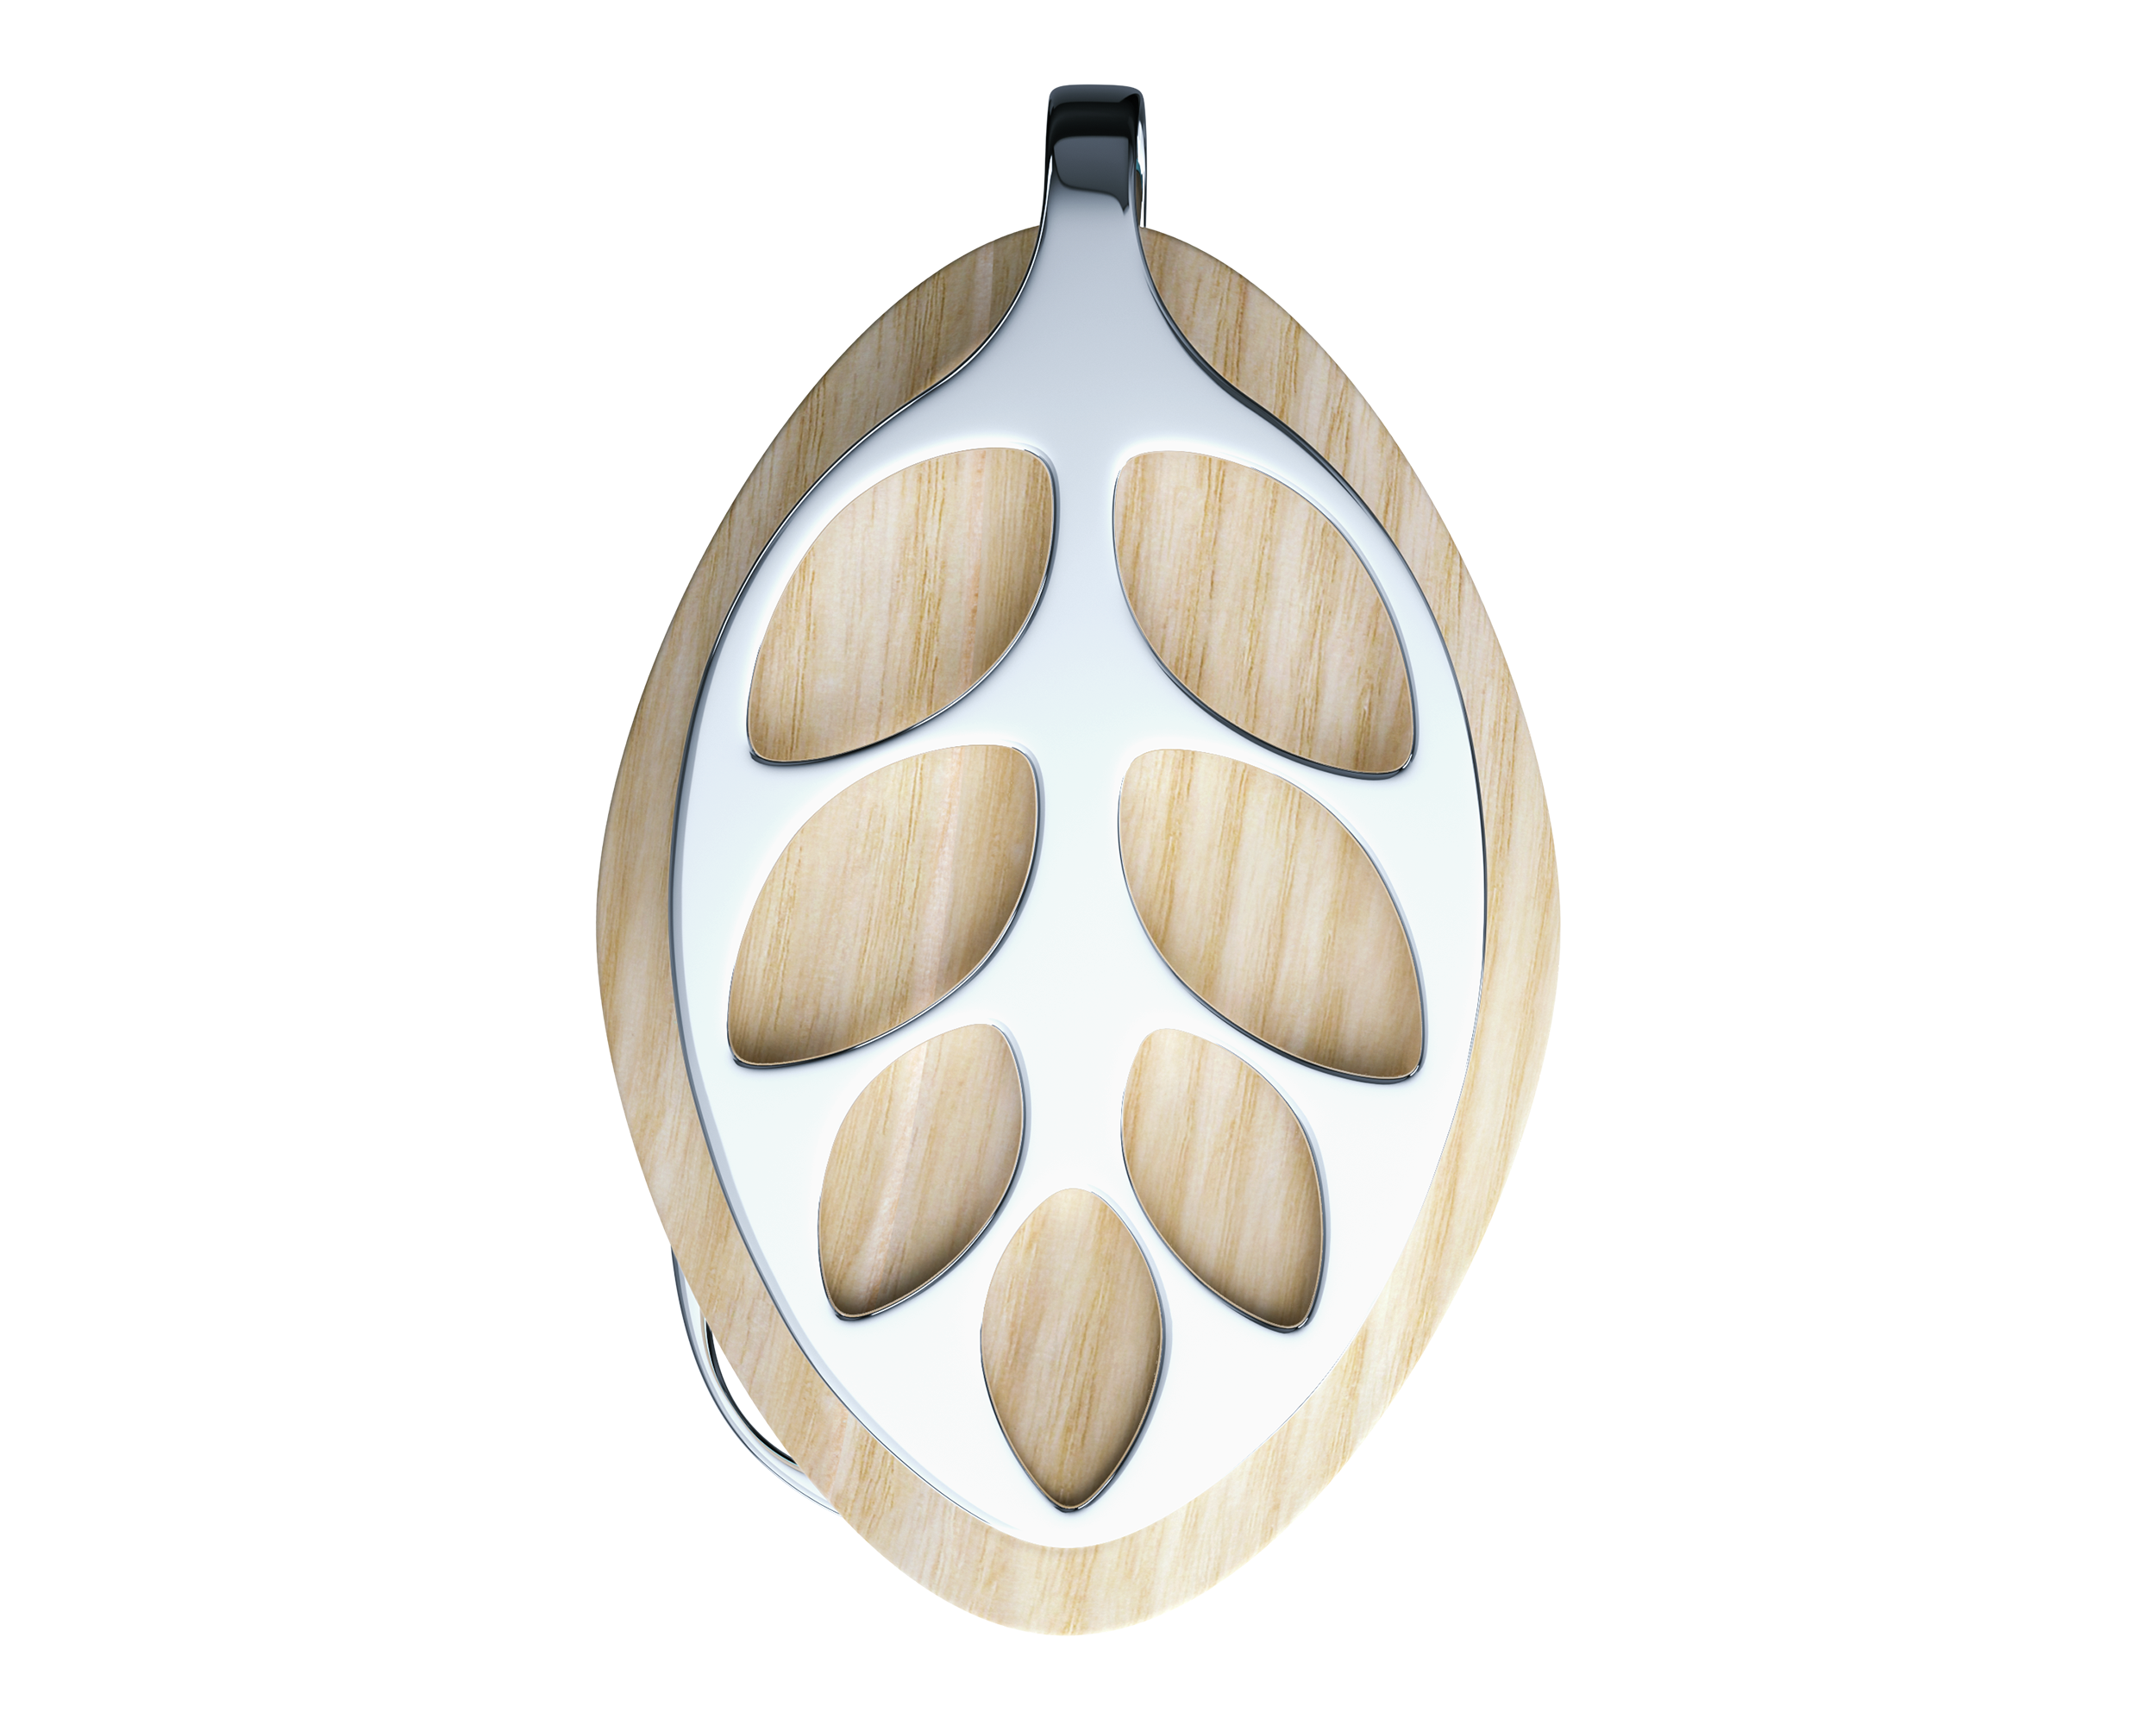

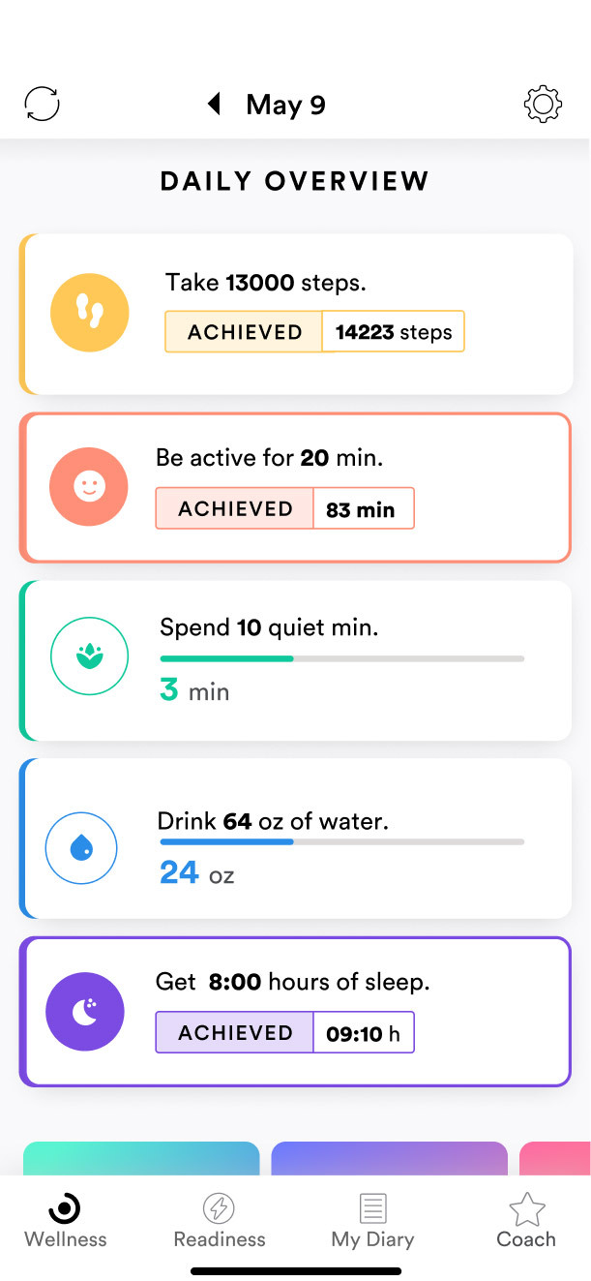

Human resources slide 1
Introduction to Bellabeat
Company Background
Founded in 2014 by Urška Sršen and Sandro Mur
Pioneers in fem-tech, focusing on women's health and wellness
Rapid growth with a strong international presence
Products:
Leaf
Ivy
Bellabeat Wellness Coach App
Bellabeat Membership
Target Market
Health-conscious, tech-savvy women
Educated, professional women valuing evidence-based wellness approaches

Slide 3


Business Task
Analyze smart device usage data to gain insights for improving Bellabeat's smart devices and marketing strategies
Key Stakeholders
Urška Sršen (co-founder and Chief Creative Officer)
Sando Mur (co-founder and mathematician)

Slide 4
Data Organization
Description of the Data Source
Source: FitBit Fitness Tracker Data from Kaggle
Content: Metrics include daily activity, sleep patterns, heart rate, and calorie expenditure.
Sample Size: Data from 33 users over 31 days.
Format:
Long Format: Most files are in long format, where each row corresponds to a single time point per user.
Wide Format: Some files are in wide format, where each column represents a different time point for a single user.

Slide 5
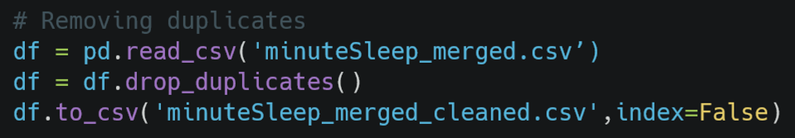
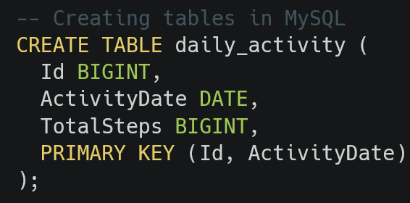
Data Cleaning and Preprocessing Steps
Tools Used:
Python
SQL (MySQL)
Handling Duplicates:
Removed duplicates in ‘minuteSleep_merged’ and ‘sleepDay_merged’ files.
Example: ‘minuteSleep_merged’ had 543 duplicates removed using Python.
Missing Values:
Converted blank values in the "Fat" column of weight_log_info to NULL.
Data Transformation:
Standardized date formats across all tables.
Example: Converted "m/d/yyyy" to "yyyy-mm-dd" format.
Schema and Table Creation:
Created schema and tables in MySQL for data storage.
Data Loading:
Loaded cleaned CSV files into MySQL tables.
Data Verification:
Verified data integrity by checking for duplicates, ensuring correct user and day counts.

Slide 6


Data Credibility and Limitations
Potential Biases:
Small sample size (33 users)
Lack of demographic data
Data not up-to-date (collected over 2 months)
Approach:
Operational focus due to data constraints
Grounded in available data while acknowledging limitations
Actionable recommendations based on insights at hand
Further research with larger, representative sample needed for definitive conclusions

Slide 7
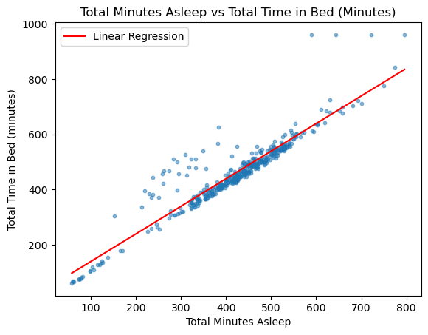
Key Findings: Sleep Analysis
Strong positive correlation between Sleep Duration and Time in Bed
Develop sleep optimization features:
Personalized sleep duration recommendations
Sleep hygiene tips and bedtime reminders
Integration with smart home devices (temperature, lighting)
Interesting Fact: Average sedentary time per user: around 16.5 hours
Notes:
Explain that the scatter plot exhibits a very strong positive correlation, with data points closely following the line y=x, indicating a near-linear relationship between the two variables. Mention that most data points are concentrated between 300 and 550 minutes (5 to 9 hours) for both total minutes asleep and total time in bed.

Slide 8
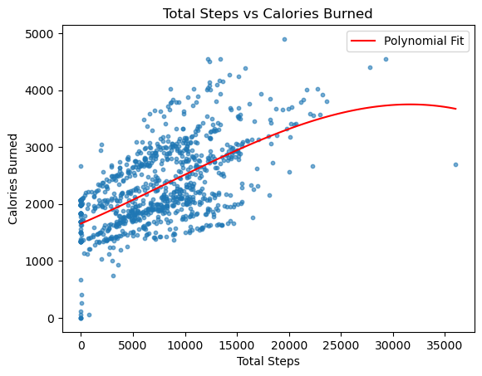
Key Findings: Activity and Calorie Expenditure
Mostly linear relationship between Total Steps and Calories Burned
Develop accurate calorie estimation models based on step data
Key selling point for fitness tracking products
Simple and effective calorie monitoring without additional sensors
Interesting Fact: Average total steps per user: 7,638
Notes:
Explain that the scatter plot exhibits a distinct polynomial curve pattern with 3 degrees of freedom, with most data points falling in the 1,000 to 15,000 step range and 1,000 to 3,000 calories burned range. Mention that while the overall trend appears mostly linear (more steps leading to more calories burned), the presence of some outliers likely contributes to the higher-degree polynomial curve fitting.

Slide 9
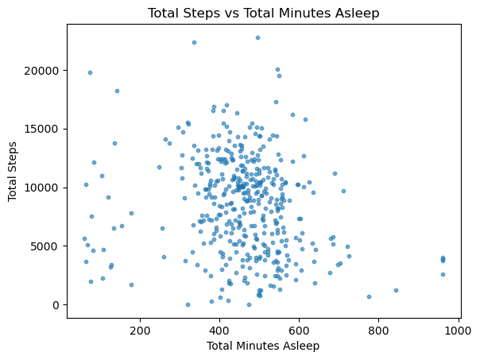
Key Findings: Sleep Duration and Activity Levels
No clear linear relationship between Sleep Duration and Activity Levels
Concentration of users within specific ranges:
Sleep duration: 400-600 minutes
Activity levels: 1,000-15,000 steps
Develop tailored product features and marketing campaigns for these segments
Sleep tracking and optimization for identified sleep range
Step challenges and activity-based rewards for identified activity range
Notes:
Explain that the scatter plot does not show a clear linear relationship between sleep duration and activity levels measured by total steps. However, mention that there is a concentration of data points within the range of approximately 400 to 600 minutes of total sleep and 1,000 to 15,000 total steps, suggesting that a significant portion of users experienced sleep durations and activity levels falling within those particular value ranges.

Slide 10
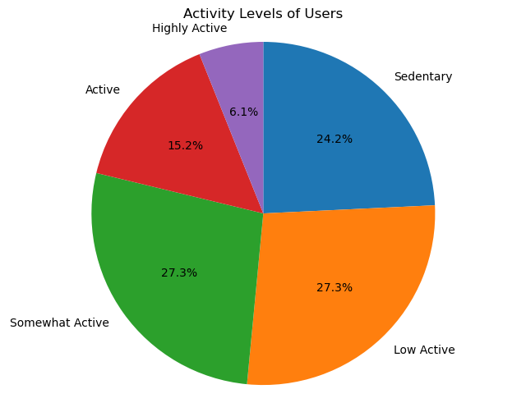
User Activity Level Distribution
Distribution of users across different activity levels (sedentary, low active, somewhat active, active, highly active)
Notes:
Provide the percentages of users in each activity level category based on their total step counts: sedentary (24.2%), low active (27.3%), somewhat active (27.3%), active (15.2%), and highly active (6.1%).

Slide 11


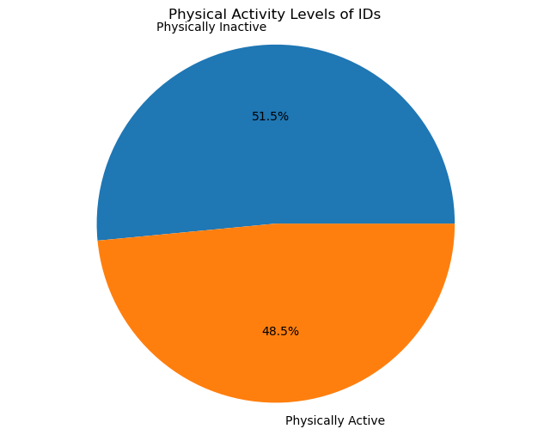
Physical Activity Levels
Physically Inactive User Segment
51.5% of users classified as "Physically Inactive“
Opportunity to promote active lifestyles through:
Personalized goal-setting and activity challenges
Rewards/gamification for increasing activity
Educational resources on health benefits
Physically Active User Segment
48.5% of users classified as "Physically Active"
Opportunity to enhance engagement and retention through:
Tailored workout plans and fitness programs
Social features for community support and accountability
Integrations with other health/wellness apps and services
Notes:
Explain that 51.5% of users are classified as "Physically Inactive" (combining sedentary and low active categories), while 48.5% of users are classified as "Physically Active" (combining somewhat active, active, and highly active categories).

Slide 12

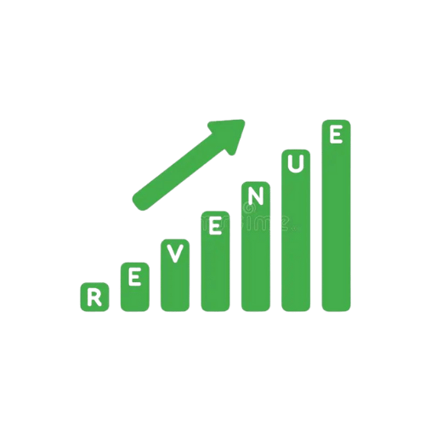
Summary and Conclusion
Key Findings and Recommendations
Strong sleep duration-time in bed correlation
Develop sleep optimization features, recommendations
Linear steps-calorie expenditure relationship
Implement accurate calorie estimation models based on steps
User concentration in specific sleep/activity ranges
Tailor product offerings, marketing for identified segments
51.5% users classified as "Physically Inactive“
Promote active lifestyles through personalized goals, challenges, rewards
48.5% of users classified as "Physically Active“
Tailored workout plans and fitness programs
Business Impact
Optimize products to meet diverse user needs
Enhance user engagement and retention strategies
Differentiate offerings with valuable sleep/calorie tracking features
Targeted marketing for high-potential user segments
Drive growth by leveraging data-driven consumer insights

Slide 13
Human resources slide 10
Questions and Discussion
Thank You
Hiep Nguyen

